Slide 1
Workplace Project
Airport Data
Kimaya Setty

Slide 2
Project breakdown
Project Landscape
Data Cleaning
Exploratory Data Analysis
Feature Extraction
Classification Model
Model Evaluation
ML Flow Evaluation
Conclusion

Slide 3
Project Landscape
The goal of this project is to develop predictive models that can classify the type of an airport based on its geographic location, service availability, and communication setup, as well as predict the expected radio frequency assignments for specific airports. By training these models on structured airport and frequency data, the system will be able to automatically categorize airports — even in cases where the type might be missing or uncertain — and suggest likely radio frequencies based on the airport’s characteristics and operational context. This knowledge can be used to support navigation systems, assist in aviation planning, and help maintain the consistency and accuracy of airport data in larger systems.
DATA
INFORMATION
KNOWLEDGE
Data set available on Kaggle
This includes the airport data:
  Location
  Airport details
  And scheduled services
This also includes the airport frequency data:
  Frquencies
  Frequencies type
  Corresponding airports
When the data is cleaned, joined, and structured, it transforms into useful information about airports and their communication setups:
Relationships
Spatial distribution
Categorical patterns
Data Completeness Insights:
  Missing geolocation, frequency, or identification codes.
  Anomalies like duplicated frequencies or misclassified types.
This forms the basis for feature engineering: extracting location-based, type-based, and service-based features for machine learning.
The knowledge goal is to develop predictive models for:
Airport Type Prediction Model
Given:
  Location
  Service indicators
Predict:
  type
Frequency Prediction Model
Given:
  Airport attributes
  Frequency purpose
Predict:
  frequency_mhz

Slide 4
Data Cleaning
The following steps are required to preprocess the dataset to ensure optimal training of the data set. The following are a list of preprocessing steps used to prepare the dataset:
Insert iso_country
Insert continent
Remove nulls
Delete empty columns
The remaining cleaning will continue during the step of Feature Extraction.

Slide 5
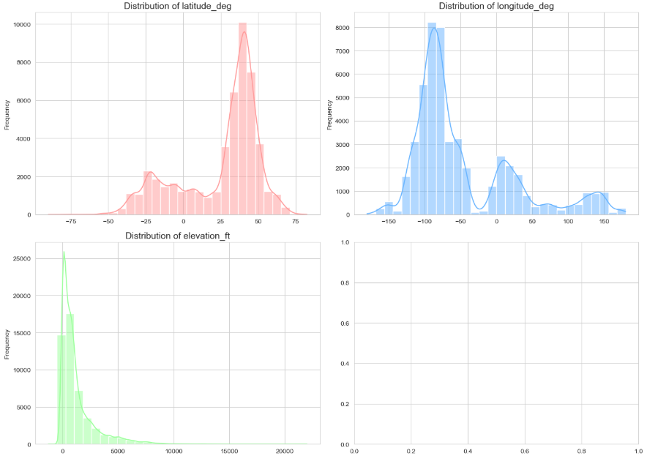
Exploratory Data Analysis
Data distribution
We can note that there is no normal distribution of data. Latititude is skewed to the right, meaning more airports in the north.
Longitude is skewed to the left meaning more airports to the West.
And elevation is very skewed to the left meaning majority of airports are at low elevation.

Slide 6
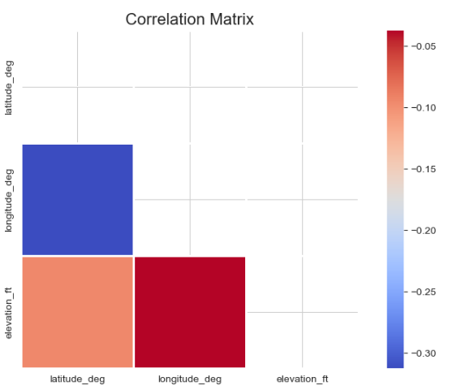
Exploratory Data Analysis
Correlation matrix
This plot indicates that there is no strong correlations between latitude, longitude and elevation.
This indications there is no dependencies between these data points

Slide 7
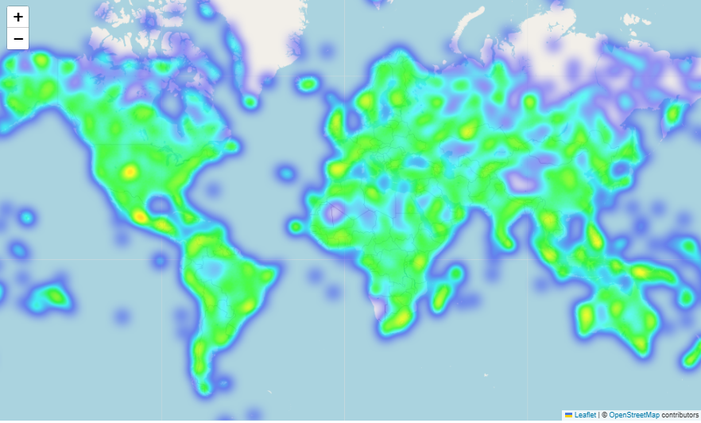
Exploratory Data Analysis
Global Heat MAP
This plot shows a rather even distribution of airports throughout the globe.

Slide 8
Feature Extraction
The following feature extraction was conducted:
Merged frequency and airport code table
Rename columns for better understanding
Encode categorical variables
Drop majority empty columns
  Unfortunately this included majority of the frequency data this is because the frequency table only accounted for a fraction of the airports available in the airport table and using this data would mean to significantly drop the size of our training dataset.

Slide 9
Classification Models
Classification Results
 | Logistic Regression | Random Forest | XGBOOST
Accuracy | 0.54 | 0.83 | 0.81
Precision | 0.48 | 0.83 | 0.80
Recall | 0.54 | 0.84 | 0.81
F1-Score | 0.38 | 0.83 | 0.79
INSIGHTS
The Random forest classification model seems to have performed the best.

Slide 10
Model Evaluation
Cross-Validation Accuracy:
 | Accuracy
Logistic Regression | 0.5389
Random Forest | 0.5389
XGBOOST | 0.8083
F1-Score | 0.38
INSIGHTS
The Random forest classification model is confirmed to have performed the best.

Slide 11
Final MODEL
Airport type | Precision | Recall | F1 Score | Support
balloonport | 0.00 | 0.00 | 0.00 | 4
closed | 0.75 | 0.01 | 0.02 | 736
heliport | 0.82 | 0.30 | 0.44 | 2021
large_airport | 0.86 | 0.51 | 0.64 | 745
medium_airport | 0.76 | 0.85 | 0.80 | 2424
seaplane_base | 0.91 | 0.25 | 0.39 | 168
small_airport | 0.74 | 0.95 | 0.83 | 7245

Slide 12
Final MODEL
Metric | Precision | Recall | F1 Score | Support
Accuracy |  |  | 0.75 | 13343
macro avg | 0.69 | 0.41 | 0.45 | 13343
weighted avg | 0.76 | 0.75 | 0.70 | 13343
Insights
The model shows strong overall accuracy (75%) and performs well for common classes like small and medium airports, but it struggles significantly with underrepresented types such as balloonports and closed airports. The large gap between macro and weighted F1-scores highlights an imbalance issue, where predictions favor frequent classes at the expense of rare ones. Addressing class imbalance and refining the model could improve its ability to generalize across all airport types.

Slide 13
Conclusion
This project set out to explore how well different machine learning models could predict the type of an airport based on geographic and operational data from the global airport dataset. Three models were compared: Logistic Regression, Random Forest, and XGBoost.
Out of the three, the Random Forest model stood out with the best overall performance. It reached about 84% accuracy and proved consistent across most airport categories, making it a solid choice for this kind of classification task. XGBoost came in a close second with 81% accuracy, performing well but slightly less balanced in some of the smaller or less common airport classes. Logistic Regression lagged behind, hitting just 54% accuracy. It was only able to predict the most common class reliably and failed to distinguish between other types.
One of the biggest challenges was the uneven distribution of airport types in the data. Categories like balloonport or seaplane_base had very few entries compared to others like small_airport, which made it tough for the models to learn meaningful patterns for the rarer types. This issue led to low scores for those classes, especially in precision and recall.

Slide 14
Conclusion
Given the results, the Random Forest model is currently the best option. However, there’s room to improve by addressing the imbalance in the data. Techniques like SMOTE (Synthetic Minority Oversampling) or other sampling strategies could help even things out. It may also be worth trying out other ensemble methods, tuning model settings more carefully, or adding new features that group airports by location or size to help the model make better predictions.
It is also important to note that we could not create a model to determine frequency used by an airport and this is because the data avaiable for frequency was too small to create a robust model. A future work would be to find a larger data source of frequency to create such a model. We could also refine the dataset to make a model with a smaller data set but many varaibles would need to be removed so an evaluation of the viability of this solution is required as well.
Looking ahead, the focus should be on refining the chosen model, improving the dataset’s balance, and building a system that can be updated regularly as new data becomes available.

